Slide 1
Applied Capstone Project Greek Restaurant Location in Columbus, OH
By: Jonathan Pitts

Slide 2
Introduction/Business Problem
In this capstone project I have chosen to figure out the best location in Columbus, OH to build a Greek restaurant based on most visited venues
Background Discussion
Columbus is a fast growing city. In June of 2016 Columbus won a grant from the Department of Transportation totaling 40 million dollars for the Smart City initiative. This is one of many business ventures Columbus has taken on. With that said, the private sector has been growing too. Because of that, the demand for many types of restaurants has increased. Columbus is home to many cultural cuisines. Japanese, Chinese, Indian and Mediterranean cuisines are common place in Columbus. It's a great place to grow a restaurant business.
Data methods to use:
In order to accomplish this I will want to find the top Greek venues from a 10 mile radius of greater Columbus (Smith Brothers Hardware Building). Then I will use folium to find the best place to put a Greek Restaurant. I won't want to have two Greek Restaurants close together. Then after I show that data in a data frame, I will show in a folium map the venues to make it easy to see the clusters and understand where the most populated areas are. Then I will pitch the best site to build a restaurant on.
Who would be interested in this (shareholders)?:
Anyone looking to open a Greek restaurant in Columbus, OH.
Data that will be used:
I will use the Foursquare API to bring in venues located near Columbus.
Methodology:
I plan to use Foursquare API to bring the code in and Folium to show the location of the Greek restaurants so that I can determine where a good location might be for a new business.

Slide 3
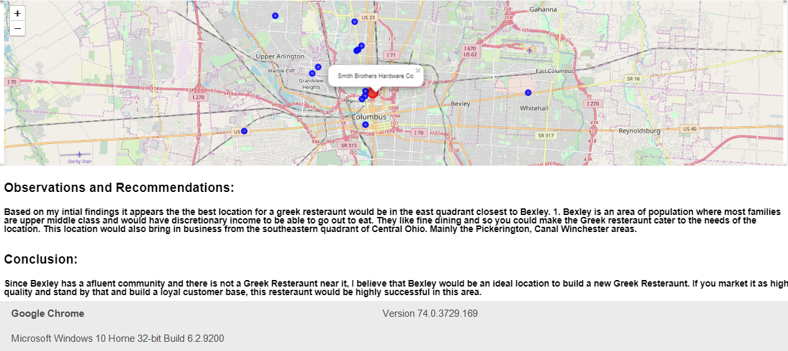
Result:
Build site here
Canal Winchester
Pickerington
References:
https://www.techrepublic.com/article/how-columbus-ohio-parlayed-50-million-into-500-million-for-a-smart-city-transportation-network/
https://en.wikipedia.org/wiki/Bexley,_Ohio

